Slide 1
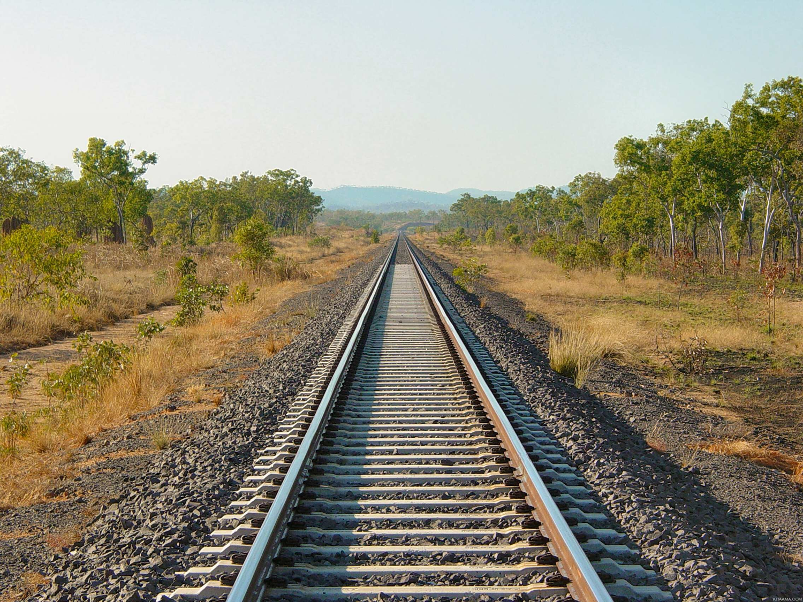
Requirement Analysis
&
Prototyping

Slide 2
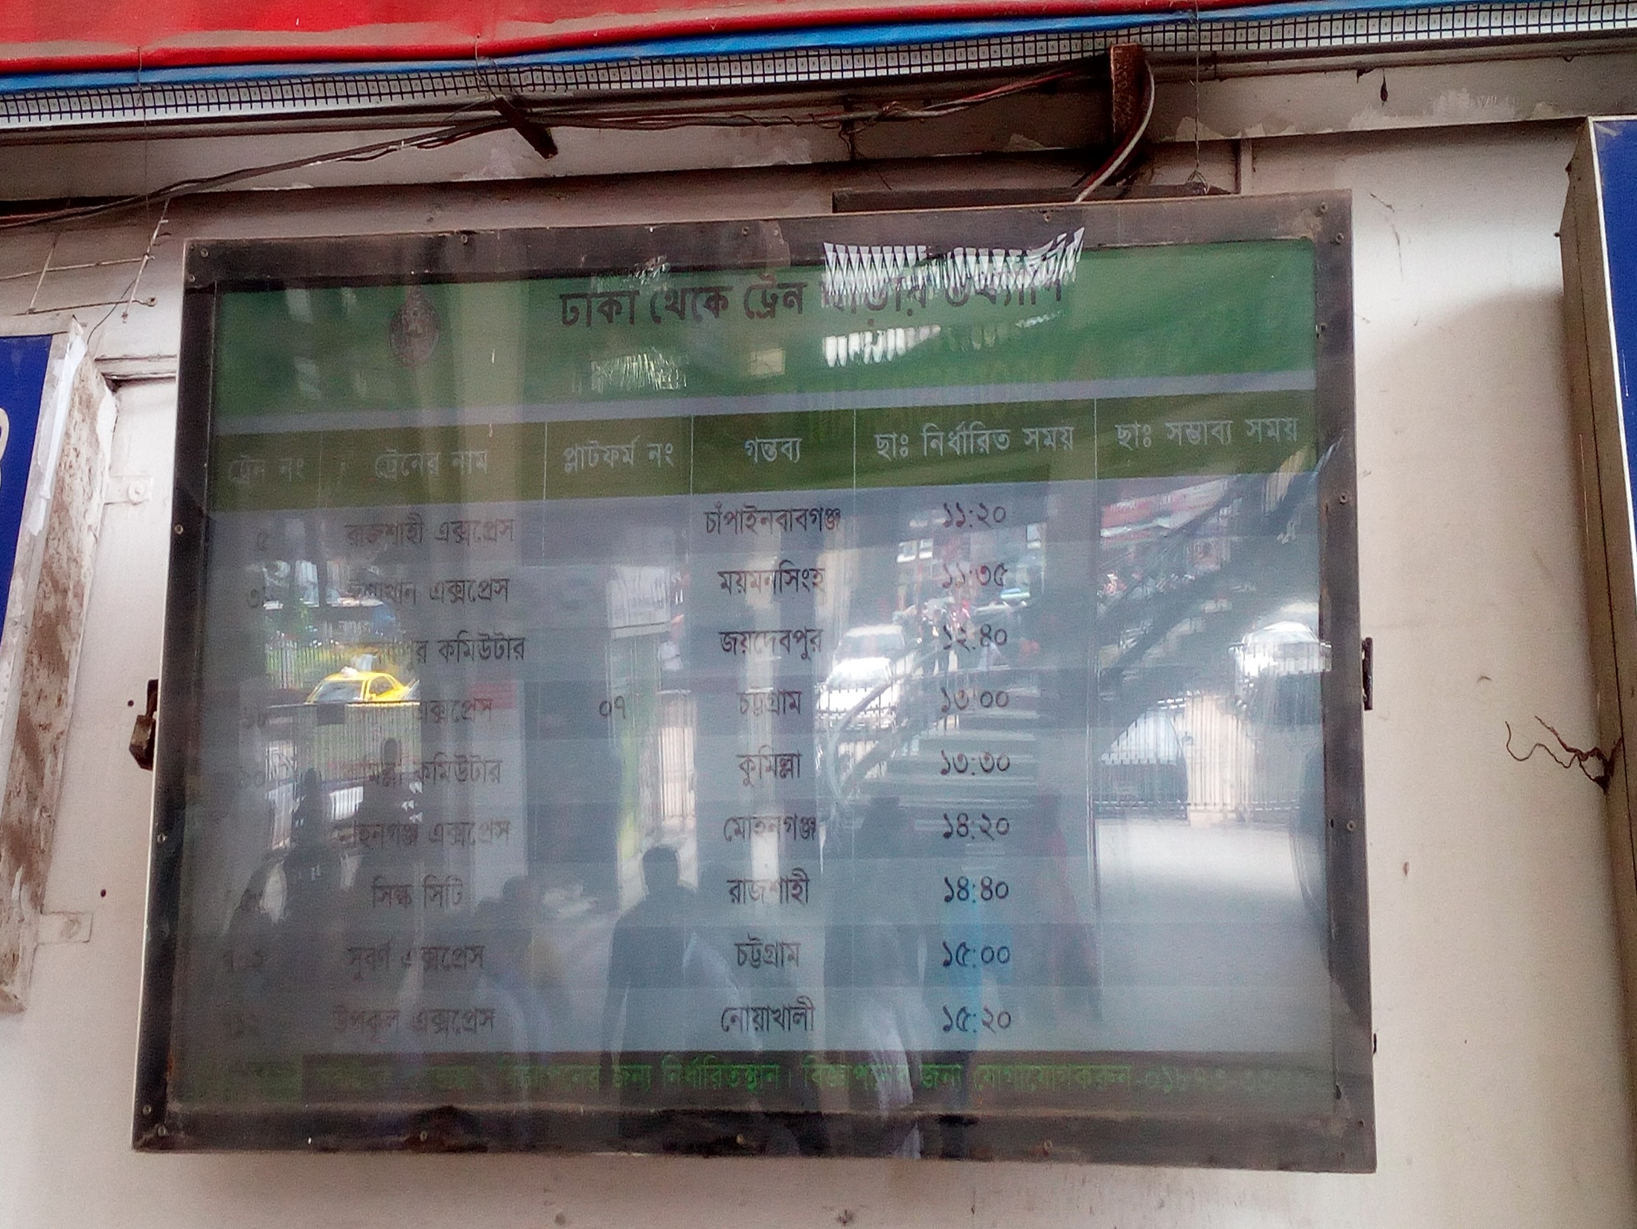
Current System

Slide 3
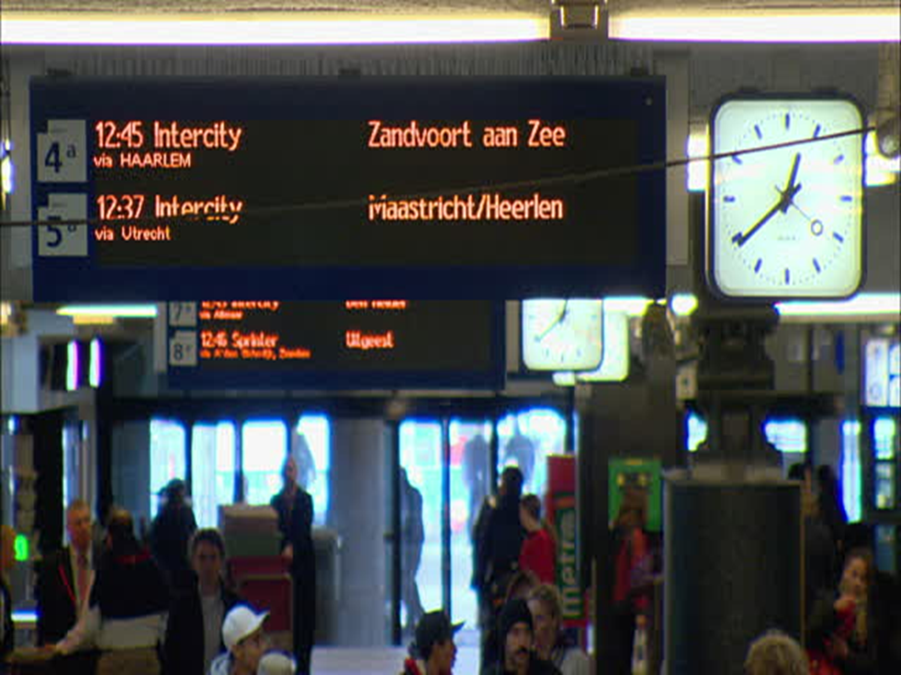
Requirement
Automated time scheduling
Using GPS

Slide 4
User Friendly Train Information
Available train from a certain station to anther station.
Departure time
Approximate time to reach any station
Available seats and accommodation classes
Ticket fare

Slide 5
User Friendly Station Information
Available stations in each district
Exact location in Google Map
Nearby Stations

Slide 6
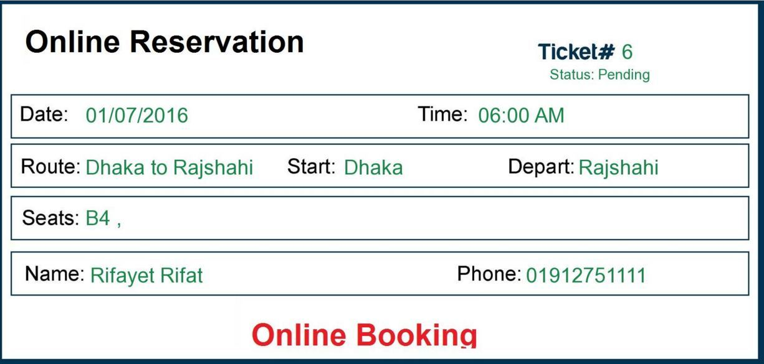
Online Ticket Booking
4 tickets per NID for a single ride
A total of 8 tickets per NID in a month
Ticket will have a serial code generated while booking online
TTE will match the serial code with ticket number while checking the tickets

Slide 7
Prototype

Slide 8
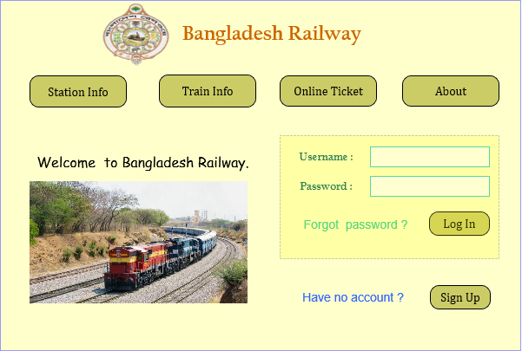

Slide 9
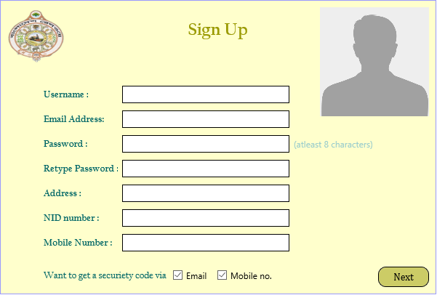

Slide 10
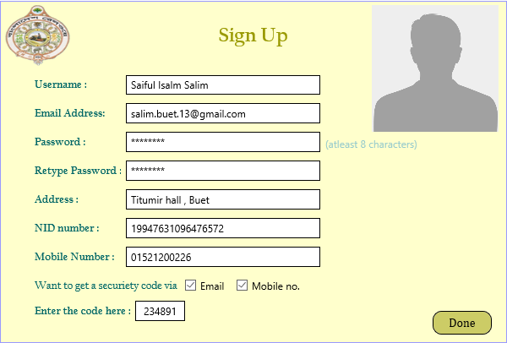

Slide 11
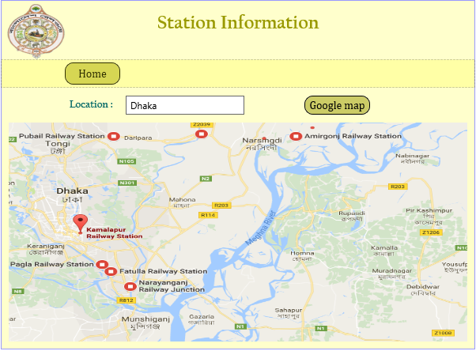

Slide 12
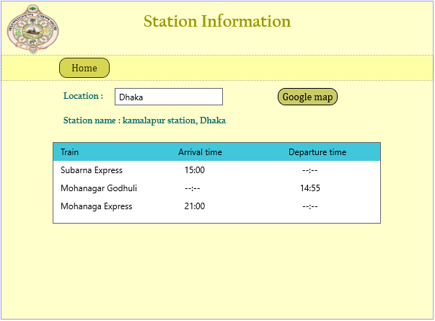

Slide 13
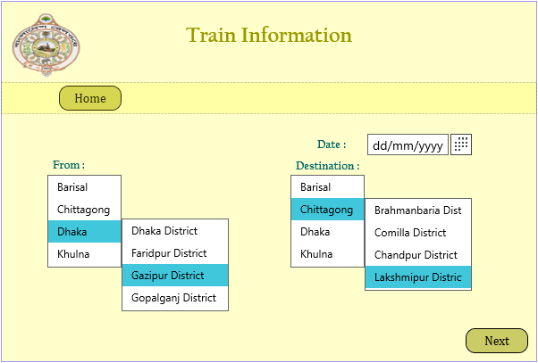

Slide 14
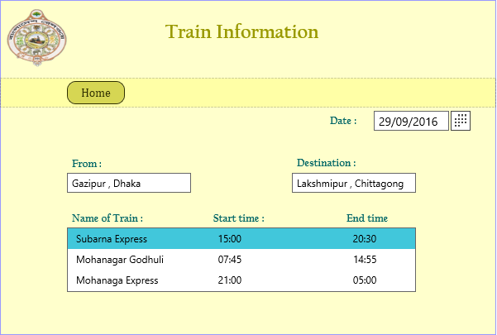

Slide 15
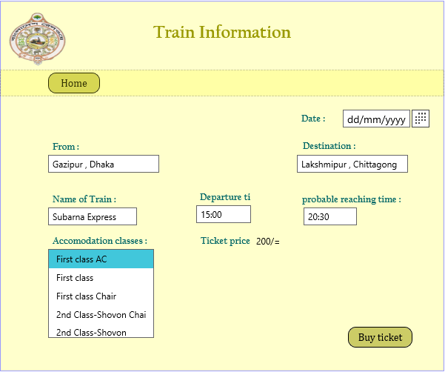

Slide 16
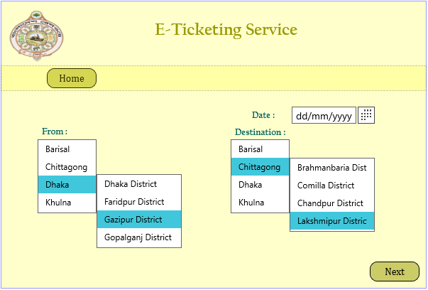

Slide 17
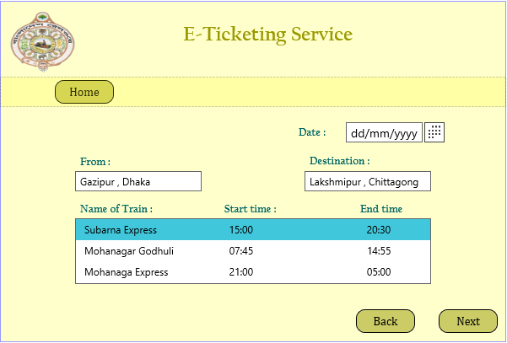

Slide 18
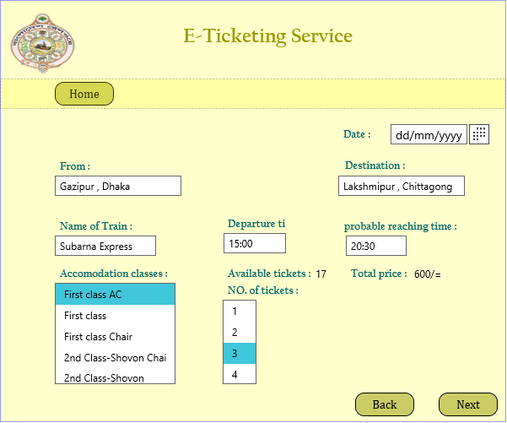

Slide 19
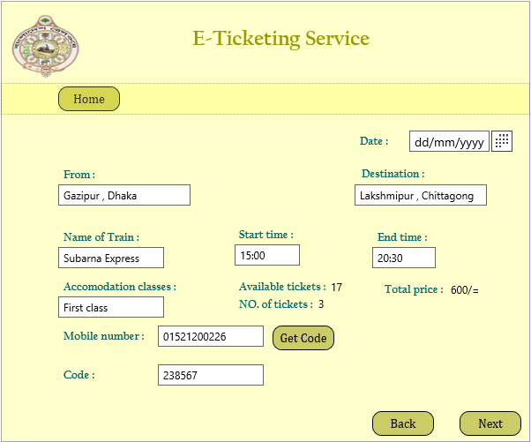

Slide 20
Thank You!

